Slide 1
South Lewis Central School District
November Faculty Meeting

Slide 2
Goals:
Promote a Growth Mindset to EVERYONE – Believing We Can All Get Better is the Biggest and Most Important First Step
Instructional Priorities for the Year:
Post and Know your Major Goal or Essential Knowledge you want Students to Master Each Day
Check for Understanding at the End of Lessons to Make Sure Students Have It
Ways we Can Incorporate Technology to Enhance Learning for Students

Slide 3
Guest Speakers:
Stacy Houppert – School Based Dental Program
Kim Palmowski – School Based Health Center
No co-pay

Slide 4
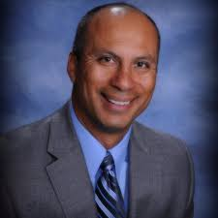
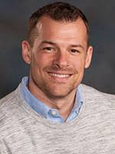
Review from Oct. 10 Supt. Day:
Select a Quote from the Table
Share
Why did you select the quote you did?
What is something you remember about Weston or Jimmy’s presentations that you feel is most important?

Slide 5
Remind Everyone of the Call for Expertise:
BE A TEACHER LEADER
Call for Expertise – Any Area of Technology
NYSUT Rubric Standard VII: Teachers set informed goals and strive for continuous professional growth. In a world of rapidly expanding access to information, opportunity, and technology, educators have a responsibility to continually prepare themselves to align instruction with transforming student needs. Continued professional growth and development is essential to creating dynamic learning environments. Teachers use information from a variety of sources to inform their professional development and practice.
Name:
Title:
Presenter(s):
Overview:
Please submit this form to Kristy McGrath by 11/9/17.
We would like at least 1 proposal per team/grade level/dept.

Slide 6
John Hattie’s Effect Size:
Weston referenced Hattie’s work, and the classroom strategies that have the largest (and smallest) impact on student learning
Review the hand-outs
With a partner complete the tasks in the Google Doc and be prepared to share
https://docs.google.com/document/d/106YQen0ZmQ4-i0UDkelAKEkQkHj6-COPrfOaNkjmS-8/edit?usp=sharing
Please keep these hand-outs with your plan book, and frequently reflect on your practice – are you increasing the time you use the strategies that have the largest impact??

Slide 7
Goals:
Promote a Growth Mindset to EVERYONE – Believing We Can All Get Better is the Biggest and Most Important First Step
Instructional Priorities for the Year:
Post and Know your Major Goal or Essential Knowledge you want Students to Master Each Day
Check for Understanding at the End of Lessons to Make Sure Students Have It
Ways we Can Incorporate Technology to Enhance Learning for Students

